Slide 1

datacenter meetup – April 2019 #SCUGno

Slide 2
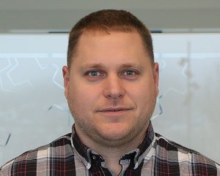
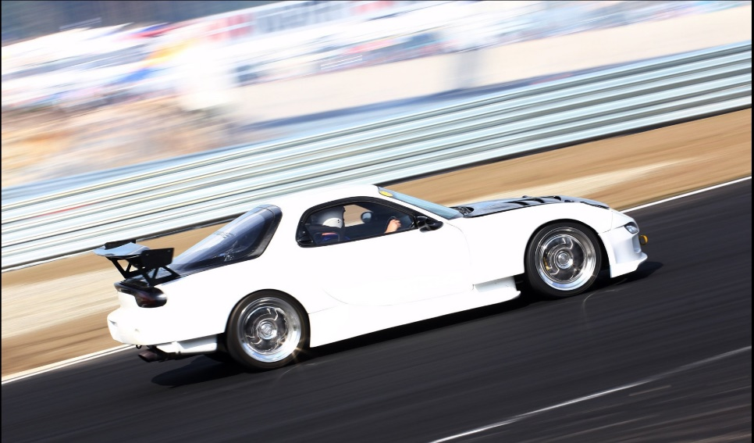
Jan-Tore Pedersen
Senior Consultant @ GTClobal
Blog: https://jtpedersen.com
Twitter: @jantorep
Speaker and Organizer for SCUG.no
Azure Stack HCI S2D
System Center
Software-defined Datacenter
Azure
Azure Stack

Slide 3
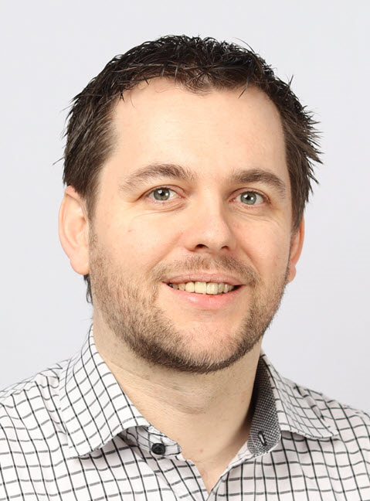
Jan Egil Ring
Lead Architect @ Crayon
Blog: https://powershell.no
Twitter: @janegilring
Speaker and Organizer for SCUG.no & Azure User Group Norway
Azure
Azure Stack HCI S2D
System Center

Slide 4
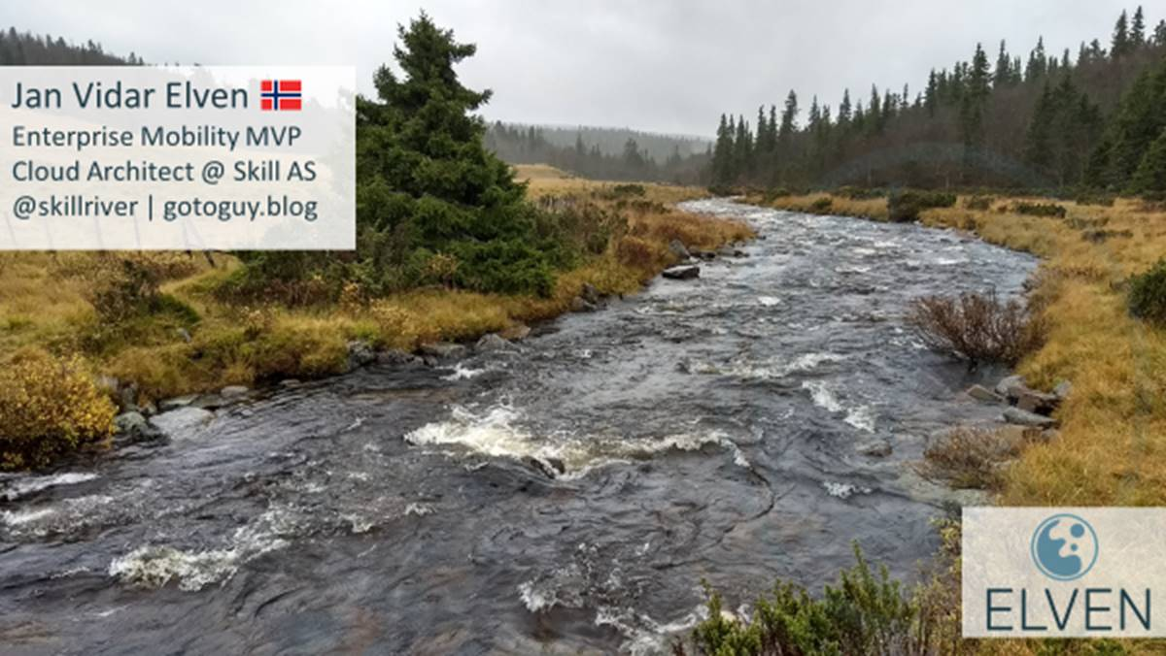
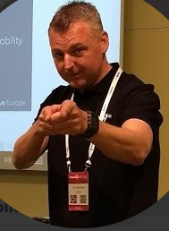

Slide 5
Agenda
09:00 – 09.15 | Velkommen
09:15 – 10:15 | Session 1: What’s New in System Center 2019 (Jan-Tore & Jan Egil)
10:15 – 10:25 | Pause
10:25 – 11:25 | Session 2: Service Manager & Orchestrator 2019 - Hva er nytt i Modern Service Management i en Hybrid Verden (Jan Vidar)
11:25 – 12.00 | Lunsj
12:00 – 13:00 | Session 3: Backing up your enterprise with Data Protection Manager (Jan Egil)
13:00 – 13.10 | Pause
13:10 – 14:10 | Session 4: Deploying and managing your HyperConverged S2D solution with Virtual Machine Manager (Jan-Tore)

Slide 6

Who is behind?
The board
Who is running this thing?
Microsoft
Big thanks to Hanne Wulff and the DX team at Microsoft
The sponsors
Non-Profit
Strategic partners which delivers relevant technology
Notes:
Foreløpig er det kun 2 stk. bak.
Først og fremst - Anders Skaug. En frivillig illsjel med masse passion for VMM, Hyper-V og Datacenter. Uten ham ville vi helt klart ikke være her i dag. Så jeg ønsker at vi gir ham en god applaus. I tillegg til det er det meg selv som stitter som styrets leder. Vi ønsker å få inn 3 medlemmer til med et like sterkt ønske om å skape et System Center – miljø i Norge hvor vi sammen setter Norge på kartet. Landet som leverer fantastik bra System Center kompetanse og løsninger.
SCUG er en non-profit organisasjon, frivillig og veledig sådan. Men vi er fortsatt avhenig av midler og kaptial for å drive dette. Dermed har vi laget et sponsorprogram som vi er stolte av og vi har allerede flere sponsorer med på laget. Kommer straks tilbake til disse. Justine Javelosa hos Microsoft, har vært så snille å låne oss lokalene vi sitter i i dag. I tillegg har Justine vært en stor bidrags-yter for å sørge for at alt er på plass til i dag og inkl. Markedsføring av eventen. En stor takk til deg Justine. Applaus alle sammen!!

Slide 7




Sponsors
Gold
Silver
Bronze
Notes:
Vår sponsorer!
Disse er foreløpig med på laget og ser virkelig verdien av det vi prøver å skape her i dag!
1E og Secunia har signert opp som Gold. Vårt øverste program.
Nutanix har signert opp som Silver og LabCenter! Samtlige selskap er representert i dag. Jeg anbefaler alle her til å ta kontakt da de besitter mye kunnskap og gode løsnnger som kan gi merverdi til System Center!
En stor takk til dere for bidraget deres. Vi ville uten tvil ikke klart dette uten og ser frem til et langt samarbeid!

Slide 8






System Center Suite overview
Provision, deploy
Configure
Monitor
Automate
Protect
Self-service
Provision fabric, deploy and manage VMs, and deploy multi-tier apps
Configure, patch and update clients and servers
Monitor physical, virtual and cloud infrastructure and workloads in real time
Automate management tasks using graphical and scripting tools
Backup private clouds, physical machines, clients, and server applications
IT process management and self-service
VMM
CM
OM
SCO/SMA
DPM
SM

Slide 9
Evolve your management approach to suit workload needs
DATACENTER
REHOST
REFACTOR REARCHITECT REBUILD
Workload
Physical servers | VMs
Azure VMs
Azure Containers | PaaS | Serverless
Windows Admin Center
Management of Windows Server instances
Microsoft System Center
Management approach
Datacenter management: Monitoring, Config. Mgmt., Provisioning, Automation
Windows Server management at scale,
custom monitoring (e.g., Azure MP, workload MPs)
Azure Security and Management
Security assessments and advanced threat monitoring for VMs/apps
Governance, Security, Monitoring, Resiliency, Automation
Azure Database Services
Built in Intelligence, Performance, Reliability, Data Protection
(e.g., Azure SQL Database, Cosmos DB)

Slide 10


Server management—at scale and individually
System Center
+
Windows Admin Center
Datacenter-scale management & monitoring
Individual-server or small-cluster management
Deploy and manage Hyper-V, WS clusters at data center scale right from bare metal with VMM
Browser-based remote management for troubleshooting, configuration, and maintenance
Extensible & scalable monitoring platform in SCOM
Reimagined, lightweight, single-server and single-cluster drill-down management
Alerting, notifications, third-party workloads monitoring
Extensible, modern platform and spiritual successor to MMC and traditional in-box tools
Integrations with SC Service Manager & other service management tools
Optimized for management of individual 2–4 node HCI clusters
Data Store for historical trending & reporting
Cloud-ready and hybrid Azure integration capabilities
Automation platform in Orchestrator/SMA
Alternative to using Remote Desktop for remote management

Slide 11



System Center focus
First choice for datacenter management
Light up management for Windows Server vNext
Integration with Azure

Slide 12
System Center journey
2007
2008
2009
2012
2013
2016
2018
Q1 2019
System Center
2007 RTM
System Center
2007 R2
System Center
2012 R2
System Center
1801 & 1807
System Center
2007 SP1
System Center
2012 RTM
System Center
2016
System Center 2019

Slide 13
Upgrade to System Center 2019
2016
2019
Long-Term Servicing Channel (LTSC) releases
October 2016
Q1 CY 2019
1801
1807
Semi-Annual Channel (SAC) releases
February 2018
July 2018

Slide 14
Virtual Machine Manager

Slide 15

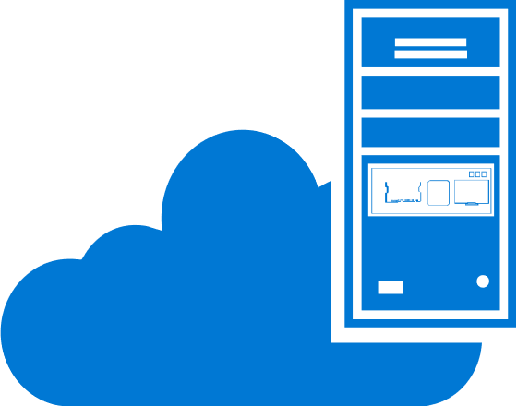



VMM 2019
Compute
Support V2V migration from VMWare 6.5, Nested Virtualization
Virtual Machine Manager VM and cloud management
Storage
Upgrade and patching of S2D clusters, Storage Optimization, Storage Health
Networking
Physical network (L2) info for Hyper-V hosts, L3 gateway support, encrypted networks, floating IP for guest clusters
SDDC
Security
New VM administrator role

Slide 16
Storage optimization

Slide 17




CSVs run out of space...
Cluster
Free storage space:
10 GB
Free storage space:
0 GB
Free storage space:
40 GB
Free storage space:
20 GB
CSV1
CSV2
CSV3

Slide 18

Optimizing Storage space
Cluster
Delegated Admin
Can set free storage threshold for VHD migration
Example: 5GB
Free storage space:
5 GB
Free storage space:
25 GB
Free storage space:
40 GB
Free storage space:
20 GB
Free storage space:
20 GB
CSV1
CSV2
CSV3

Slide 19
Demo—Storage Optimization

Slide 20
Storage Health in VMM

Slide 21



Storage health and operational status
Health & Operational Status
Storage Pool
LUN
Physical Disk
Storage health and operational states provide insights to troubleshoot

Slide 22
Demo—Storage Health

Slide 23


Upgrading storage spaces direct cluster
S2D Cluster
WS 2016
WS 2016
WS 2016
WS 2016
WS 2019
Clean OS installation
Cluster
Functional Level = 2016

Slide 24
Upgrading storage spaces direct cluster
S2D Cluster
WS 2016
WS 2016
WS 2016
WS 2019
Cluster
Functional Level = 2016

Slide 25
Upgrading storage spaces direct cluster
S2D Cluster
WS 2019
WS 2019
WS 2019
WS 2019
Effortless
VMM orchestrates the entire workflow
Seamless
Zero downtime for workloads
Cluster
Functional Level = 2019

Slide 26
VM Admin role

Slide 27

VMM Roles
New!
Fabric/Delegated Admin
VM Admin
Tenant Admin
Read
Write
Compute
Network
Storage
Compute
Network
Storage
Compute
Network
Storage

Slide 28
Demo - VMM Roles

Slide 29
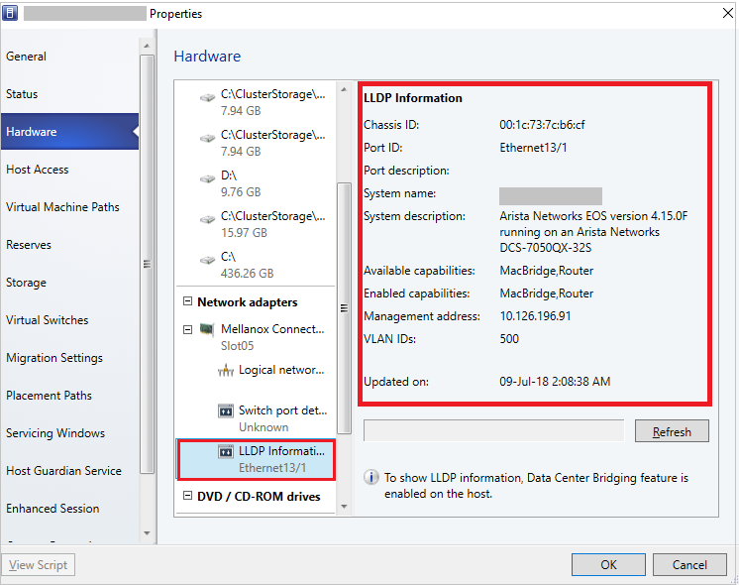


Host layer 2 network information*
Layer 2 info for troubleshooting
‘Link Layer Discovery Protocol’ used to enumerate details
*Also in VMM 1807

Slide 30
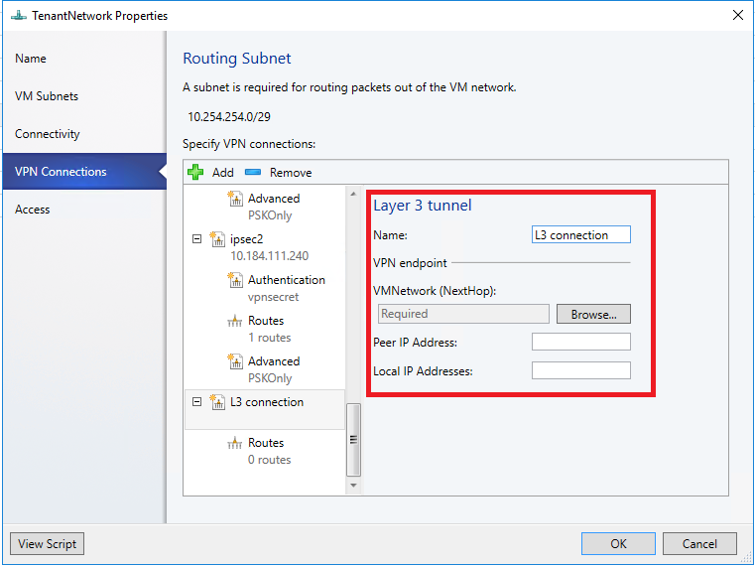
Connect your virtual network with datacenter physical network
GUI support for L3 Forwarding gateway creation
Connection over LAN Isolated network

Slide 31
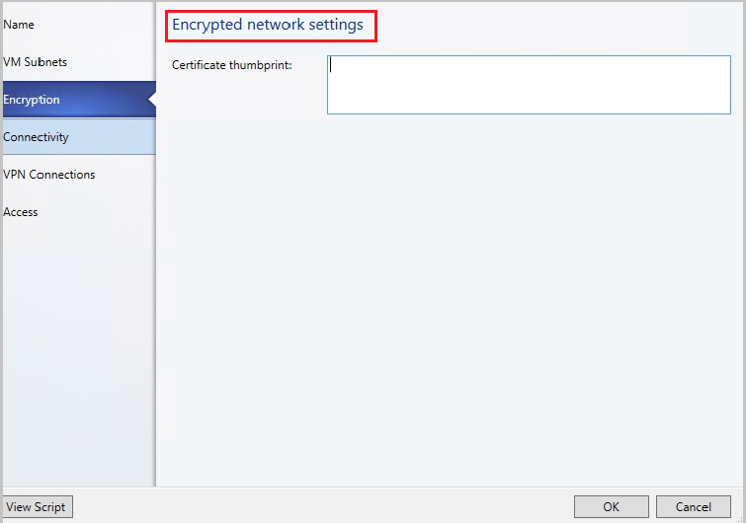
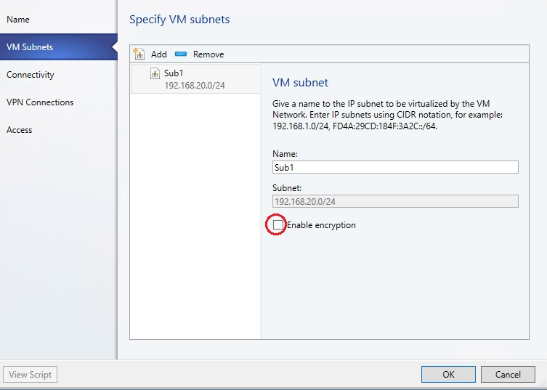


Secure data in transit between VMs in a subnet*
NC controlled Virtual Network
Subnet A
Subnet B (encrypted)
Effortless
One-click encryption
Secure
Encrypts the data in transit between VMs
*Also in VMM 1801

Slide 32
Migrate UEFI VMware VM to Hyper-V Gen 2 VM

Slide 33





Gen 2 V2V conversion from ESXi to Hyper-V*
Convert Virtual Machine Wizard
Auto detect source VM Firmware Configuration
ESXi Host
(Ver 6.5 or older)
Hyper-V Host
Select default Hyper-V VM generation
Default enable secure boot option if EFI firmware
VM with UEFI firmware Configuration
Gen-2 VM

Slide 34
…and more with hybrid

Slide 35

Virtual Machine Manager VM & cloud management
Azure Management
+
Update Management
Backup
Site Recovery
Automation
Azure Migrate
SDDC

Slide 36
VMM 2019
Compute
Support V2V migration from VMWare 6.5, Nested Virtualization
Virtual Machine Manager VM and cloud management
Storage
Upgrade and patching of S2D clusters, Storage Optimization, Storage Health
Networking
Physical network (L2) info for Hyper-V hosts, L3 gateway support, Encrypted networks, floating IP for guest clusters
SDDC
Security
New VM administrator role

Slide 37
Operations Manager

Slide 38


SCOM 2019
Hybrid
Integration with Azure Service Map and Enhancements to Azure MP
Operations Manager Monitoring infrastructure resources, workloads & applications
Monitoring Experience
HTML5 dashboards, Linux log file monitoring, MP discoverability for 3rd party MPs & Linux workloads, enhanced Notifications, better Alerts management
Insights
Alerts
Improved Fundamentals
No more Silverlight dependencies, Support for SQL server 2017, Disable interactive logon, In-place upgrade
Monitoring Surface ++
Monitor Windows Server 2019, latest application servers, latest Linux distros and VSAE support for Visual studio 2017
SDDC

Slide 39




HTML5 dashboards
No dependency
Extensibility
Inline actions
Easy access
Faster resolutions
Operator friendly

Slide 40
Demo—HTML5 dashboards

Slide 41

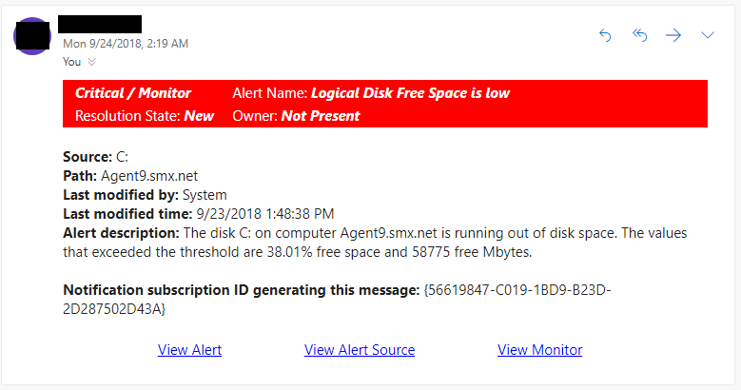
Notification and subscription enhancement
Notification email
Operator addresses issue
Administrator
Operators
Alerts Details Page
Enhanced criteria builder with ability to perform “OR” and “Exclude” operations
Easy access to relevant information about alert, alert source and rule/monitor
Remediate issue or resolve alert from the alerts details page
Trouble shoot / root cause the issue faster
Rich HTML email notification
Flexibility to customize HTML content

Slide 42


Enhanced alert management for Monitors
Current behavior
Alert generating monitor
Generates an alert
Operator works on the issue and closes the alert
Monitor is still unhealthy
Alert is closed
*upcoming
Alert generating monitor
Generates an alert
Operator works on the issue and closes the alert
Monitor is still unhealthy
Alert is not allowed to be closed

Slide 43
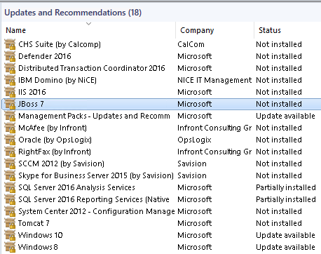

Linux/UNIX monitoring enhancements
Enhanced Linux/UNIX alerting in failover scenarios
Updates & recommendations for Linux workloads
Linux Log file monitoring
Resource Pool
Monitor any data source
Application Logs
Java/Ruby/PHP
Network Protocols
HTTP/TCP/ Syslog
Monthly Patch
Cloud Services
Azure
Others
Docker/DSTAT/ MySQL
MS1
Failover
MS2
No duplicate alerts
Generate alerts in SCOM

Slide 44
..and more hybrid scenarios

Slide 45












Azure Management Pack for SCOM
HDInsight Cluster
Service Bus
Data Factory
Storage
App Insights
Networks
Virtual Machine
SQL Server
App Gateway
Microsoft Azure

Slide 46
SCOM 2019
Hybrid
Integration with Azure Service Map
Enhancements to Azure MP
Operations Manager Monitoring infrastructure resources, workloads & applications
Insights
Alerts
SDDC

Slide 47
SCOM 2019
Monitoring Experience
HTML5 dashboards
Linux Log file monitoring
Enable/disable APM component during agent install/repair
MP discoverability for third-party MPs and Linux workloads
Enhanced notifications and subscriptions experience
Better alert management for monitors
Enhanced certificate validation for web application monitoring
Linux log rotation
Operations Manager Monitoring infrastructure resources, workloads & applications
Insights
Alerts
SDDC

Slide 48
SCOM 2019
Improved Fundamentals
No more Silverlight dependencies
Support for SQL Server 2017
Disable interactive Logon
Support OpenSSL 1.1.0 for Linux platforms
Kerberos support for Linux agent
Enhanced Agentless alerting during failover scenarios
Enhanced certificate validation for web application monitoring
Operations Manager Monitoring infrastructure resources, workloads & applications
Insights
Alerts
SDDC

Slide 49
SCOM 2019
Monitoring Surface ++
Monitor Windows Server 2019
Monitoring latest application servers like Tomcat 9, WildFly 14, WebSphere 9.0 and Web Logic Server 12cR2
VSAE support for Visual studio 2017
Monitor Ubuntu 18 and Debian9
APM—enabled Client Side Monitoring (CSM) on Edge and Chrome browsers
APM—enabled monitoring support for SharePoint 2016
Operations Manager Monitoring infrastructure resources, workloads & applications
Insights
Alerts
SDDC

Slide 50
Data Protection Manager

Slide 51
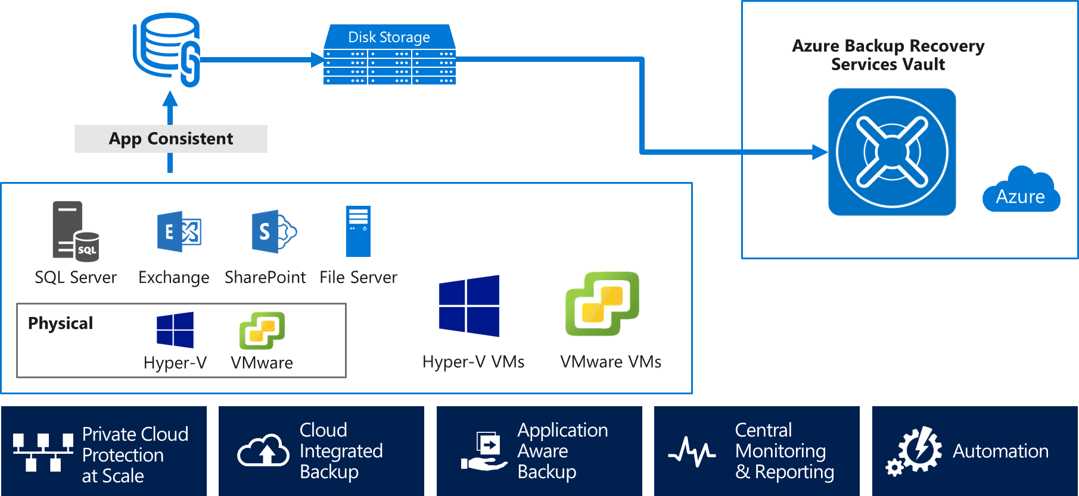


DPM 2019
Support Windows Server 2019, SQL Server 2017
VMware to tape backup
Modern backup storage improvements
Greater flexibility in recovering from Azure

Slide 52


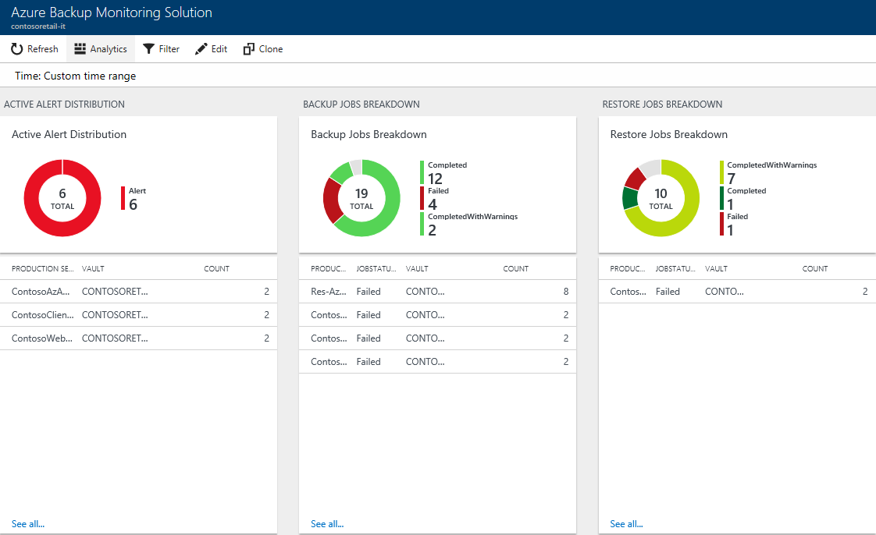
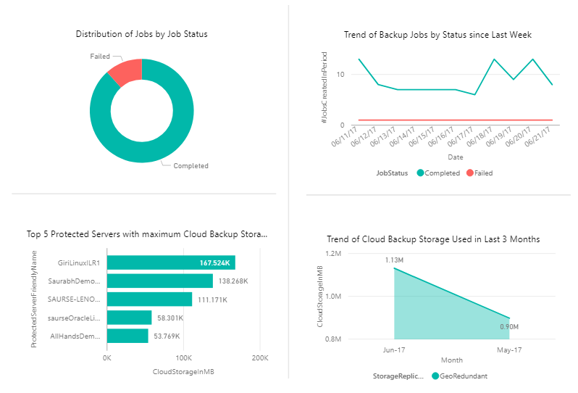
Rich Reporting and Monitoring
Log Analytics
Custom Queries
ITSM Integration
Azure Backup
No infrastructure
System Center DPM
Enterprise Wide
Power BI
Custom Reports
Azure Storage
Microsoft
Azure Backup Server
Cross tenant support

Slide 53
Configuration Manager
Configuration Management
Collect inventory
Track changes
Configure desired state
Support all patching scenarios enabled today for servers and VMs
Current branch releases aligns with Windows and Office
Update Management
Assess compliance
Schedule update installation
Cadence continues 3x per year

Slide 54

Orchestrator
Process Automation
Orchestrate processes using graphical, PowerShell, and Python runbooks
Configuration Management
Collect inventory
Track changes
Configure desired state
Orchestrator 2019
64 bit support
PowerShell v4 +
SQL 2017
Support for TLS 1.2
Update Management
Assess compliance
Schedule update installation
Azure Functions
Event driven, compute on-demand, events occurring in Azure, third-party, or on‑premise systems
Heterogenous
Windows & Linux
Azure and on-premises
upcoming

Slide 55
Service Manager
Service Catalog
Build and deliver turnkey applications to your enterprise IT customers
Service Manager 2019
Improved UI responsiveness
AD connector improvement
SQL 2017
Support for TLS 1.2
Azure Policy
Enable security and management at scale for Azure resources
Azure Blueprint
Ticketing
Partner-enabled solutions
upcoming

Slide 56
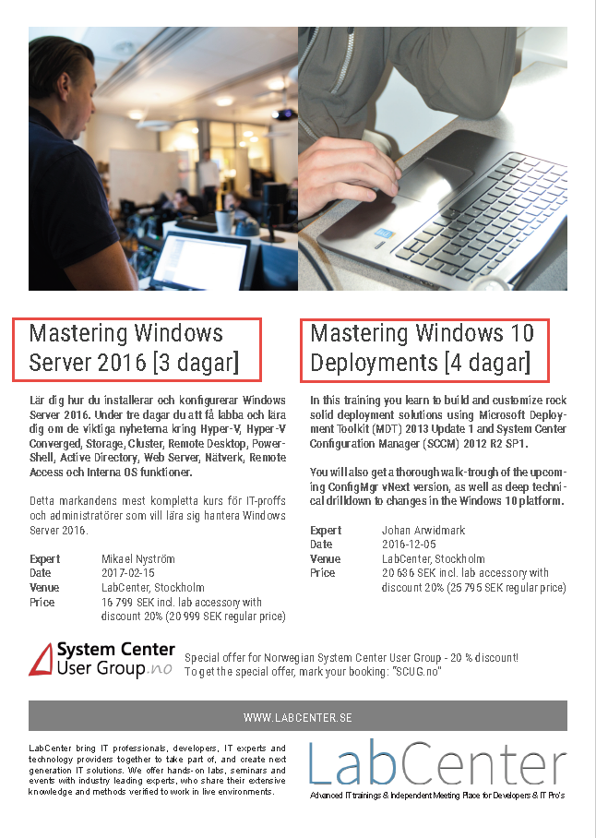
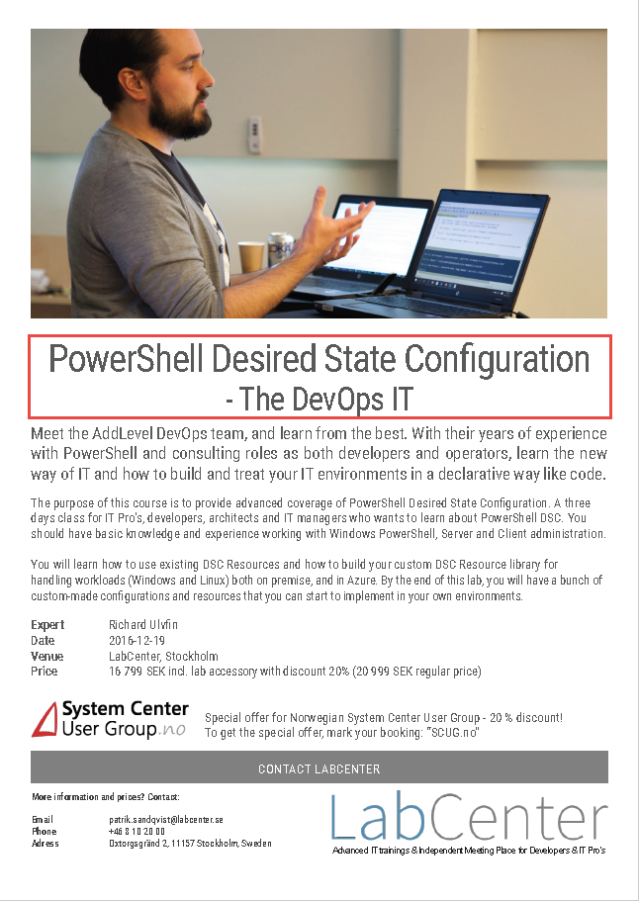
Offer only for SCUGno members
www.labcenter.se

Slide 57
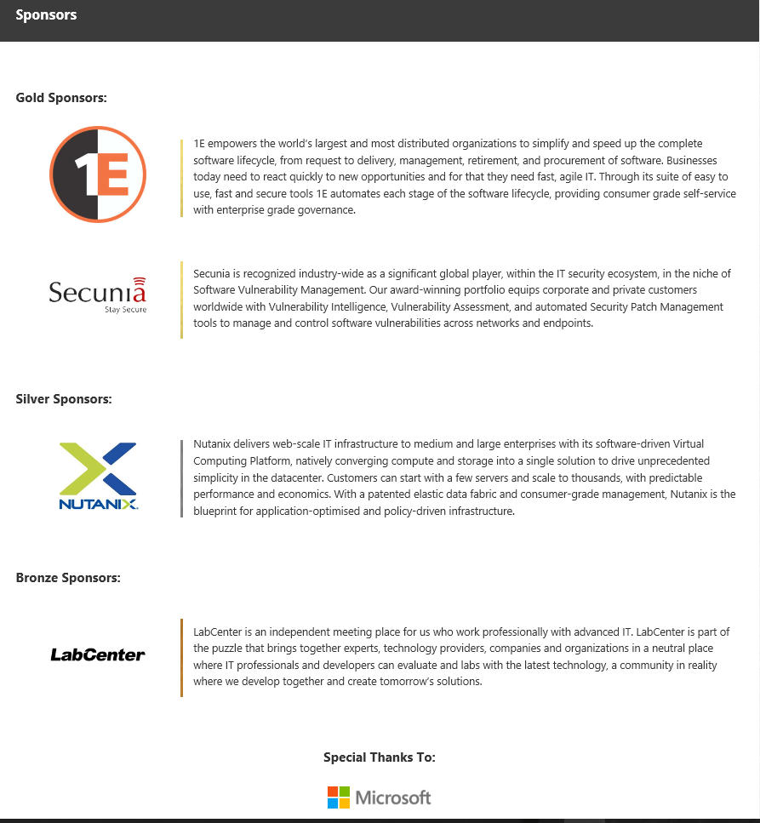
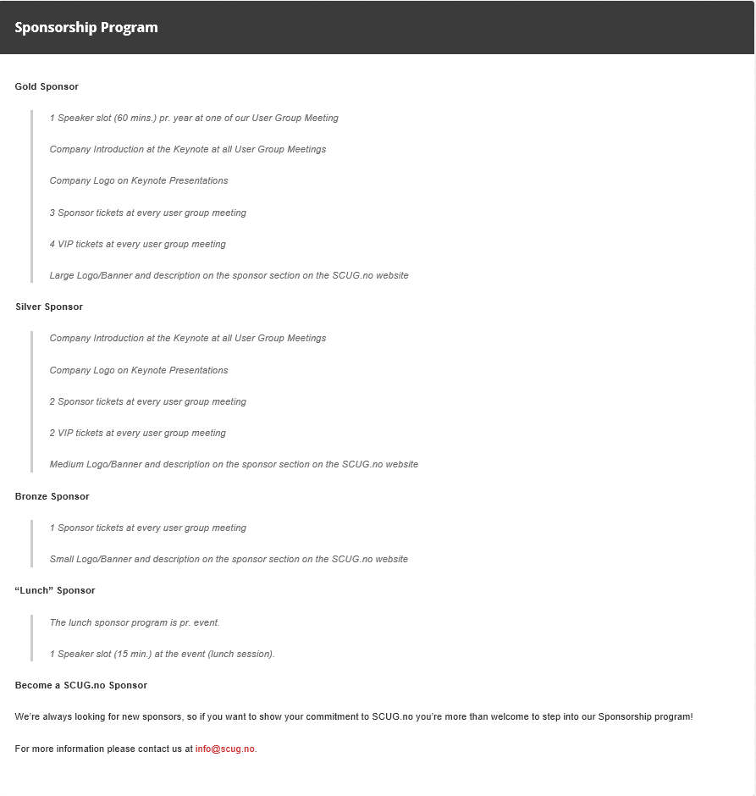

Want to contribute?
-
We are always on the lookout for more sponsors
Checkout our sponsorship program
Visit www.scug.no
www.scug.no/sponsors
Notes:
Vi er alltid på utikk etter nye samarbeidspartnere. Og om du eller noen ønsker å bidra så anbefaler jeg at dere tar en tur til vår webside og ser på sponsorprogrammene vi har.

Slide 58


Want future Updates?
Like | & | Follow us!
@SCUGNorway
www.facebook.com/SCUGNorway

Slide 59


Let’s get Social and Share!
#SCUGno
#SCUGno
#SCUGno
#SCUGno

Slide 60





Ask the experts
Notes:
Først litt praktisk informasjon.

Slide 61

Get in touch with us
www.scug.no
info@scug.no

Slide 62
Sharing is Everything

